Slide 1

E-Learning

Slide 2



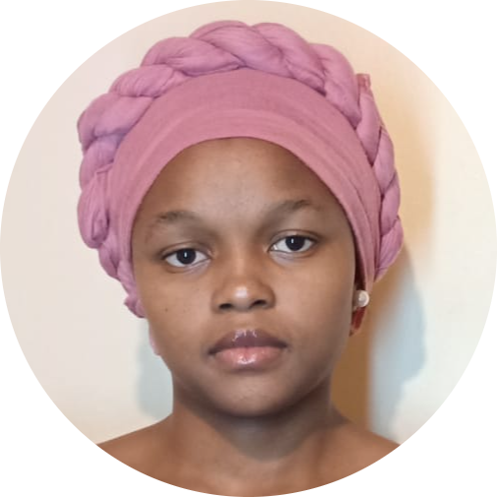



OUR TEAM
Yvonne Charawe
Android
Jane Njihia
Android
Chacha John
Back end
Ymelda Monari
Front end
Samuel Odhiambo
Back end
Violet Auko
Front end
Brian Omondi
Back end

Slide 3

Problem statement
For physical based education to be fully accessible in an online environment and still get the same quality of education.

Slide 4

Solution
The idea entails having a complete school online achieving everything the on site school does.

Slide 5
Development Process
Research
Planning
Figma designs
Testing
Development
Deployment

Slide 6

Minimal Viable Product
Web
Landing Page
Authentication Pages
Dashboard
Mobile
Student Chat
Courses activity
Attendance activity
Profile

Slide 7

Technologies used
Html
Javascript
CSS
Bootstrap
Java
Spark
Figma

Slide 8

Challenges Faced
Consuming the Apis on web using java spark was not possible so the ui for web had to be changed back to html and javascript for the consumption to be smooth.

Slide 9

Future plans
Video conferencing functionality
Implementing Co-curricular activities such as School wide quizzes and different clubs .
Students taking tests and exams.

Slide 10
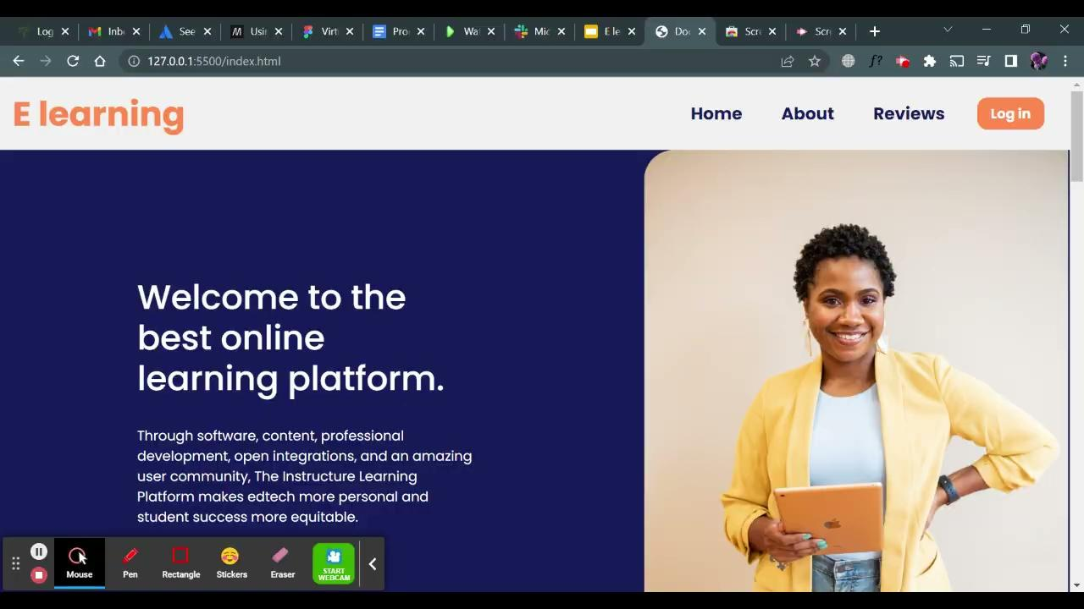
Web Demo

Slide 11
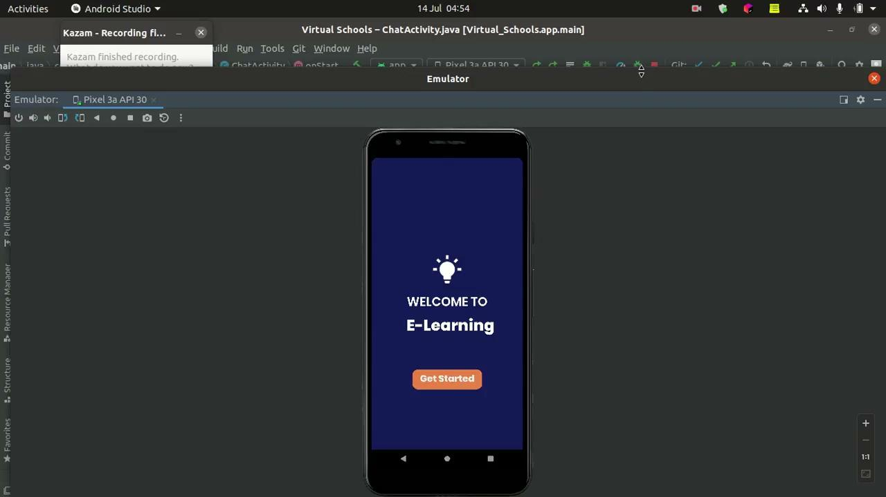
Mobile Demo

Slide 12

Q&A

Slide 13
THANK YOU

